Slide 1
Living Next Door
Get the best neighbourhood

Slide 2
TABLE OF CONTENTS
01
02
03
Project Guide and Team Members
Problem Statement
Overall Architecture diagram
04
05
06
Applicable Design diagrams
Real Time Usage
Hardware & Software Requirements
07
Overall System Architecture Diagram
MYHOME

Slide 3
Project Guide : Dr. Shriram Sir
Our Team :
Rhythm Sanghi
18BCE10216
(Module 1)
Muskan Agarwal
18BCE10164
(Module 3)
Muskan Mehrotra
18BCE10165
(Module 2)

Slide 4
Introduction
Problem Statement
Objective
Our friend is going to be moving in to the city of Bangalore, located at the edge part of the Indian subcontinent. He needs to find suitable housing. However, he frets. He wants to search for a good neighborhood that can provide him easy accessibility to daily use facilities, good pricing of houses and very less crime rate.He has come to us for help, asking us to analyze the different areas in the city of Bangalore and find which neighborhoods would be good for a newbie like him.
So as a team we have decided to help Mr. Nolan using a bit of data and a bit of science.
This project aims to utilize all the concepts learned through Data Science and find a good neighborhood in Bangalore. We define a domain problem, the data that will be used and using this we are able to analyse it by applying various ML tools. Analysis of data is step by step procedure, involves Data Gathering, Data Cleaning, Exploratory Data analysis, Data Modelling and interpreting (final output). In this project we will go through all these process and provide a conclusion that can help the people to to find a good and safe place for them to live in while moving to a new city..

Slide 5
Block Diagram Of The System
Data Collection
Exploratory Data Analysis (EDA)
Raw Data Collected
Data Collected are from APIs and different datasets
Used to to analyze and investigate data sets and summarize their main characteristics
Data is processed
Clean Dataset
Data Processed
Model & Algorithm
Data collected is translated into usable information
By using different machine learning algorithms, taking insights from data
Exploratory Data Analysis
Model & algorithm
Data Cleaning
Data Visualization
Translating information/data into a visual context and making decisions
To fix or remove incorrect, corrupted, incorrectly formatted, complete data within a dataset
Communicate Visualize Report

Slide 6
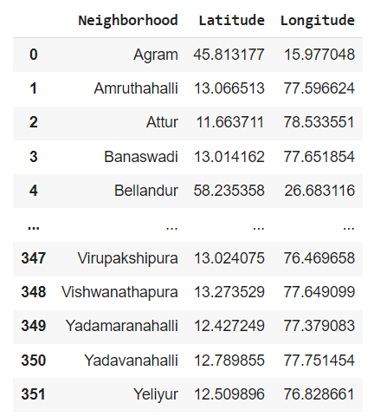
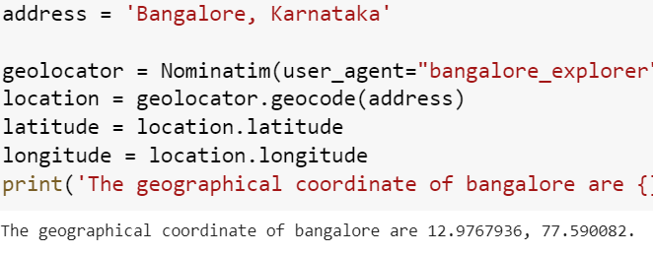
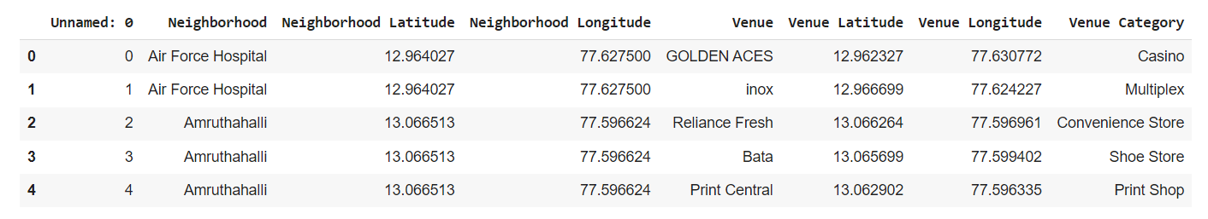
Dataset
a combination of CSV files that have been prepared for the purposes of the analysis from multiple sources
1) The list of neighbourhoods in Bangalore (via wikipedia done by web scraping).
2) The Geographical location of the neighbourhoods (via Kaggle & Geocoder package)
3) Venue data pertaining to venues (via Foursquare API)

Slide 7
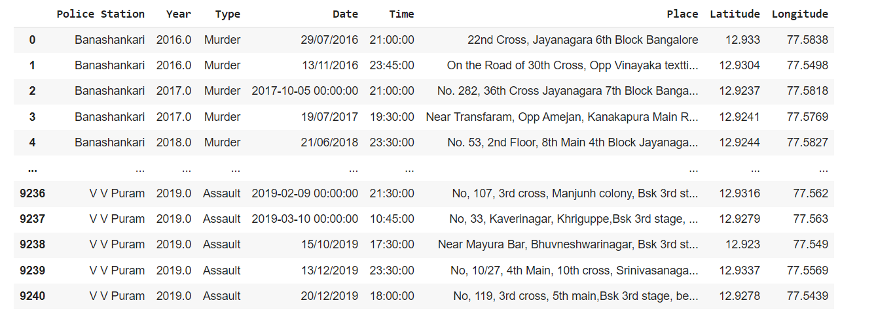
Dataset Description
This dataset provides us a look on crime in bangalore
The csv file of this dataset has been chosen from kaggle which will provide the list of neighbourhoods in Bangalore with their crimes.

Slide 8
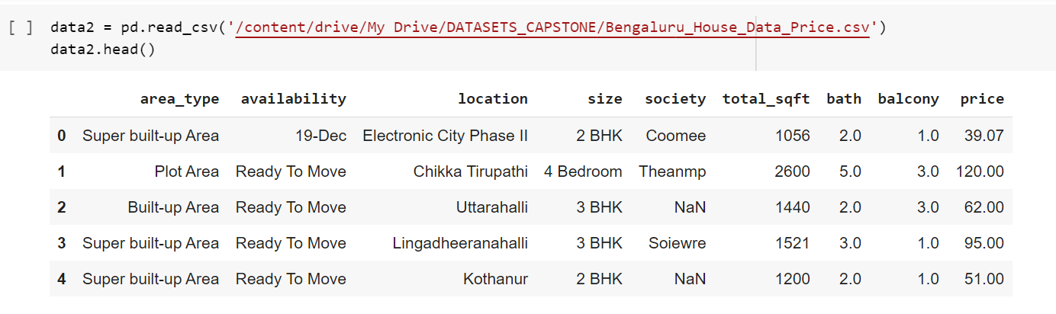
Dataset Description
This dataset provides us the prices and other details about the type of houses with their basic structural information.
The csv file of this dataset has been chosen to provide the list of neighbourhoods in Bangalore, the Geographical location of the neighbourhoods (via Kaggle & Geocoder package)
To make it more user-friendly we tried to represent the results with the help of graphs(via. matplotlib package)

Slide 9
Module 1 :
The master data's main components were Neighborhood, Latitude and Longitude as depicted below for the city of Bangalore.
The data for neighborhood and their latitude and longitudes was scraped from wikipedia pages using bs4.
Using Foursquare, individual neighborhoods are searched to find nearby venues and their categories within a 500m radius of a randomly chosen neighborhood, Banaswadi.
One hot encoding was then carried out to group more than 200 venue categories by neighborhood.
To make the analysis more interesting, we wanted to cluster the neighbourhoods based on the neighbourhoods

Slide 10
Module 2 :
This module is our Price Prediction Module. In this module we will sort and arrange the locations according to the prices .
The Kaggle dataset for prices of all location available to us provided all the information about the neighbourhood, house details, area of the house and the calculated price per square ft. along with the number of rooms in the various house locations present in Bangalore.
To reach to the final result we performed a bit of data cleansing to remove duplicate and null values. The neighbourhoods are then grouped by the name of the neighbourhood and type of area, so data clustering is made easier later on.

Slide 11
Module 3
The data contains information on crime rate for the city of Bangalore.
Plotting of data using bar is done to show the crime reported and to show the highest number of cases reported.
After that line graph is plotted to show the crime rate in different areas. This gives us a clear picture of which areas to avoid.

Slide 12
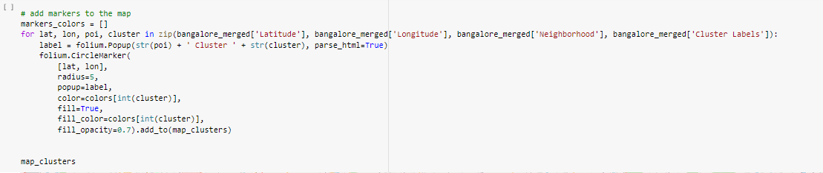
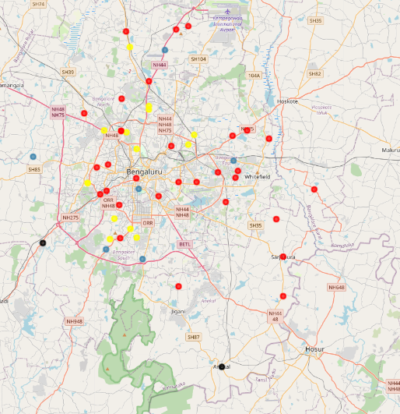
Module implementation and Results
Result from Module 1:

Slide 13
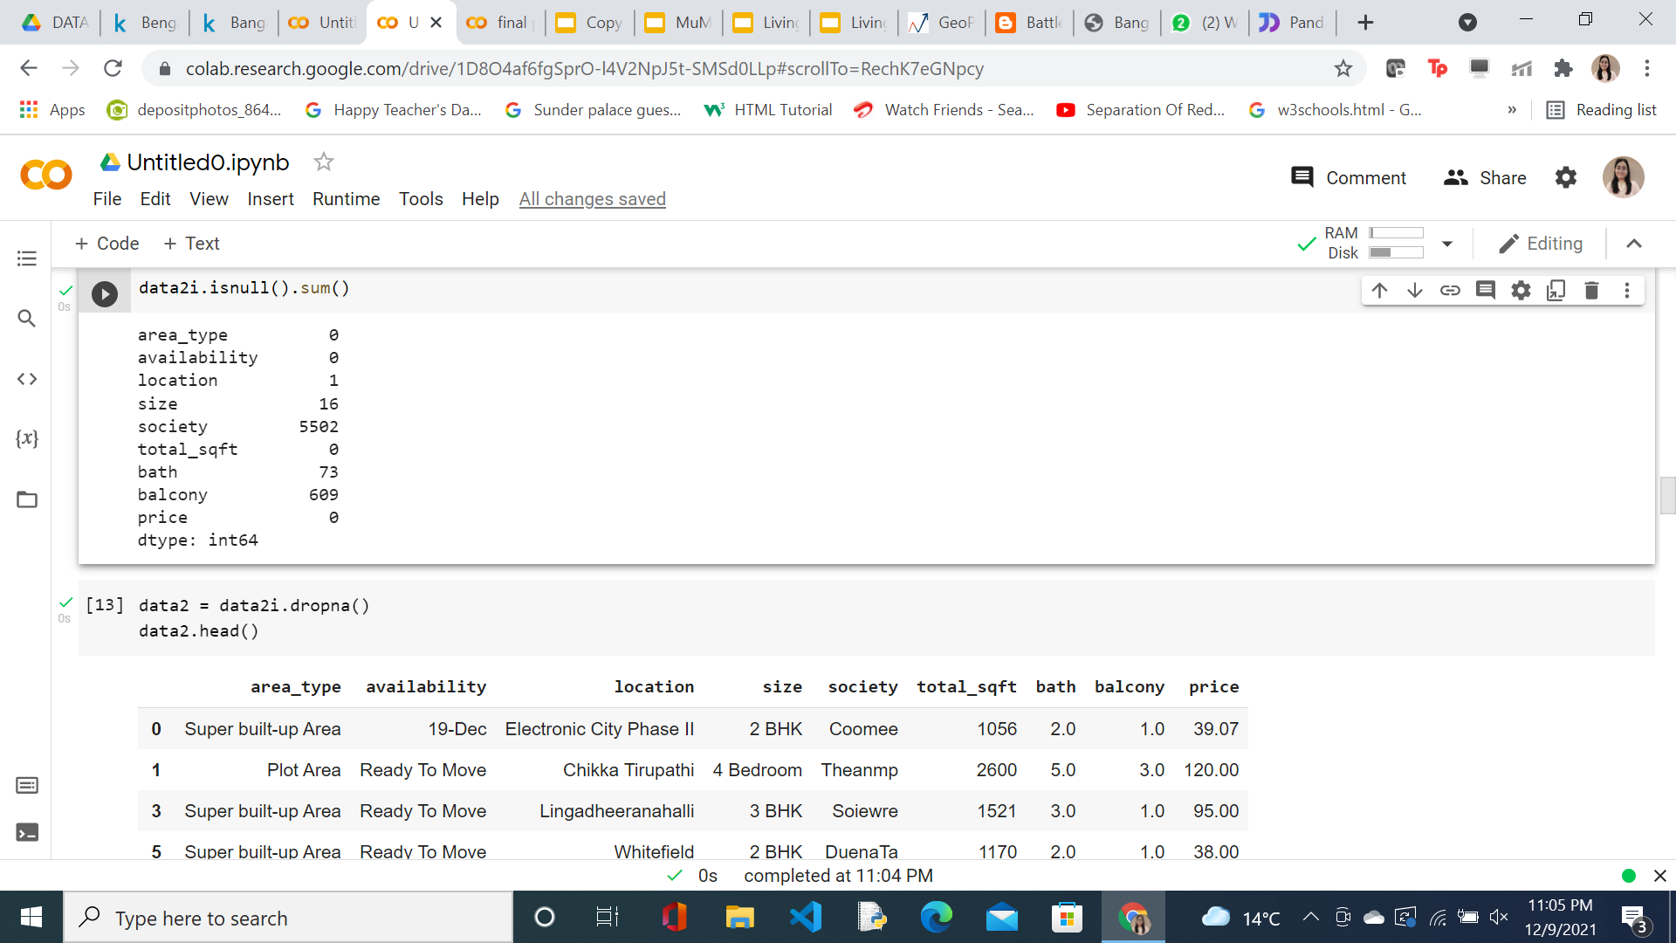
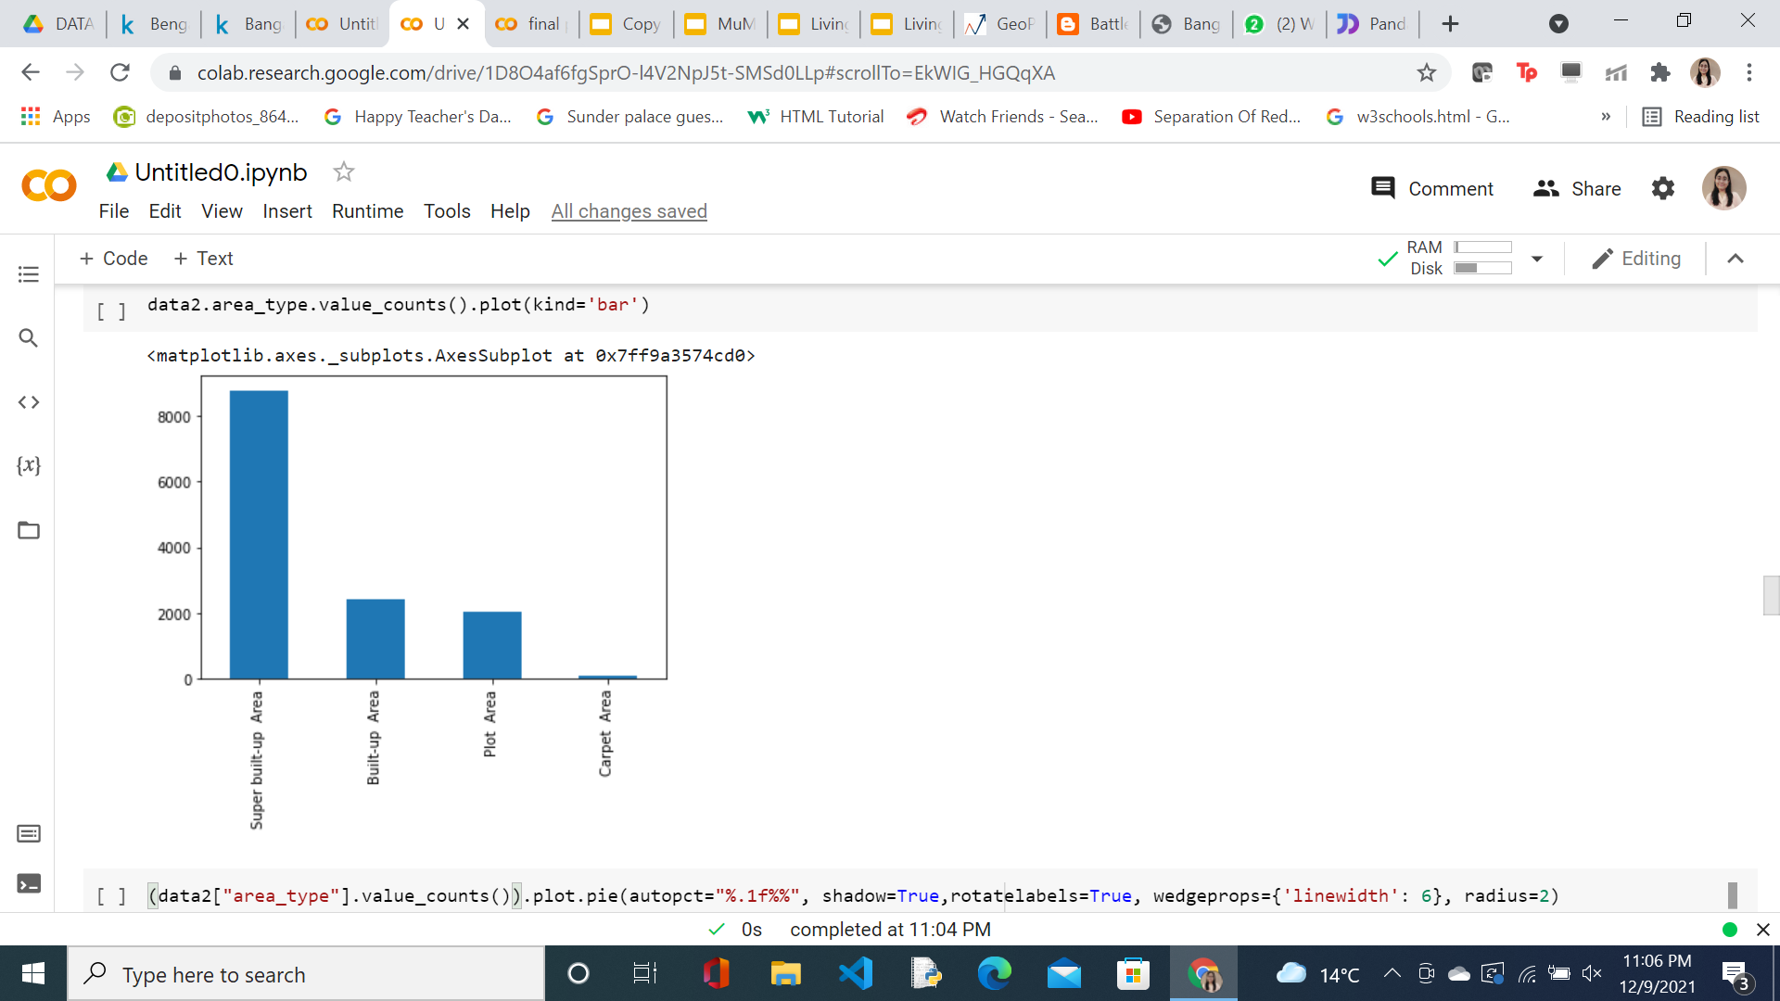
Module Implementation and Results :

Slide 14
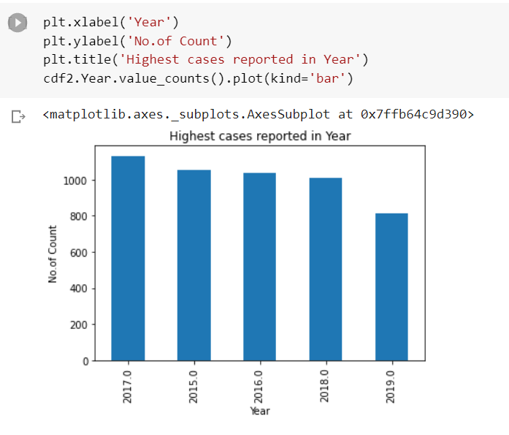
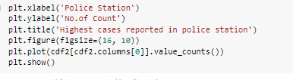
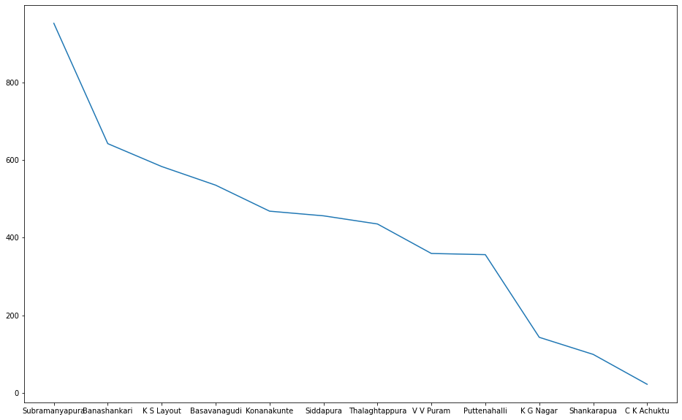
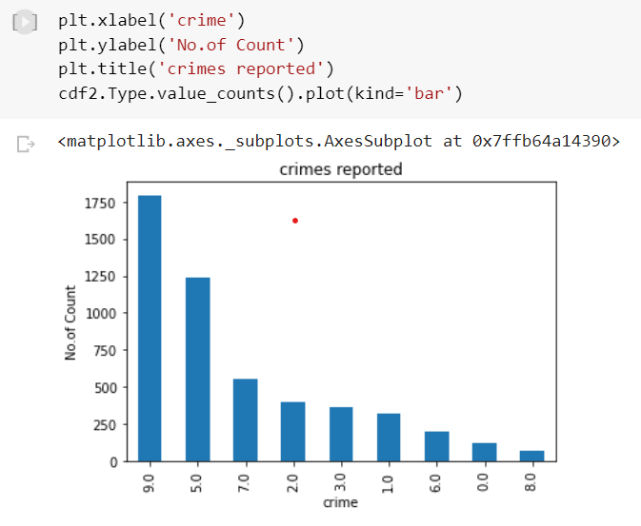
Module implementation and Results
Result from Module 3:

Slide 15
References
https://dphi.tech/courses/introduction-to-exploratory-data-analysis
https://en.wikipedia.org/wiki/List_of_neighbourhoods_in_Bangalore
https://www.kaggle.com/rmenon1998/bangalore-neighborhoods
https://www.kaggle.com/vineetsingh26/bangalore-south-crime-details

Slide 16


